Slide 1
Student Quick Guide for Registering using Vantage Website
Los Angeles | London | New Delhi | Singapore | Washington D.C | Melbourne [Updated Jan 2020]

Slide 2
HIGHLIGHTS
Dynamic Content
SAGE vantage seamlessly blends text content, videos, study tools and assignments to create a focused learning environment for students.
Knowledge Checks, Homework & Instant Feedback
Students get ample opportunity to check their understanding on readings, videos, and important concepts with knowledge checks, video activities and end of the chapter test with instant feedback on their answers.
Accessible Anytime, Anywhere
SAGE vantage is cloud-based allowing students to access course content from their internet-connected computer, tablet, or phone.
Value and Choice
SAGE vantage includes access to your eBook content, interactive videos, tests, and assignments.
Los Angeles | London | New Delhi | Singapore | Washington D.C | Melbourne

Slide 3
BEFORE YOU START, YOU WILL NEED
An internet connection or internet-enabled device
The SAGE Vantage course registration link https://vantage.sagepub.com
Your school email address
Your course ID (provided by your instructor)
To purchase access to Vantage or have a credit card to purchase access during this process
Los Angeles | London | New Delhi | Singapore | Washington D.C | Melbourne

Slide 4
There are four ways to buy access to Vantage
Three online purchase options
Redshelf
Vitalsource
SAGE
You can also purchase a physical access code from the Campus Bookstore
Los Angeles | London | New Delhi | Singapore | Washington D.C | Melbourne

Slide 5
BOUGHT VANTAGE FROM REDSHELF OR VITALSOURCE
Using the purchase link in your course syllabus complete purchase steps
Once purchased you will be directed to the Publisher website
Los Angeles | London | New Delhi | Singapore | Washington D.C | Melbourne

Slide 6
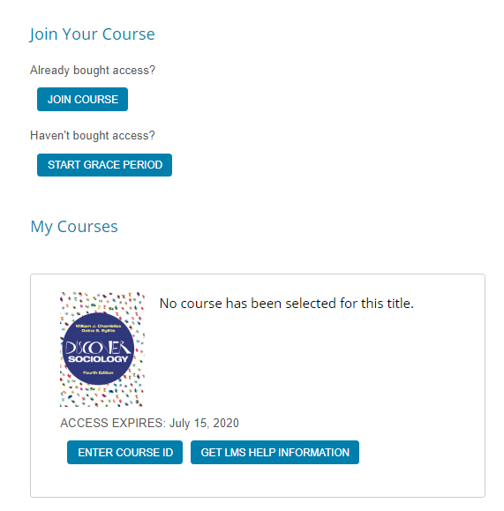
X
NOTE: You will NOT get OR need an access code
Login to Vantage
Click ENTER COURSE ID
Type in your COURSE ID
Click REGISTER FOR COURSE
Los Angeles | London | New Delhi | Singapore | Washington D.C | Melbourne

Slide 7
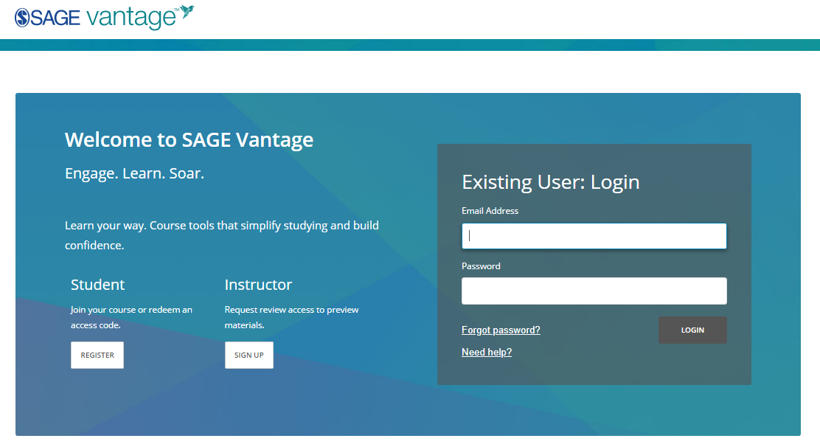
BOUGHT VANTAGE FROM THE CAMPUS BOOKSTORE:
Visit https://vantage.sagepub.com
Click “REGISTER” beneath “Student”
Los Angeles | London | New Delhi | Singapore | Washington D.C | Melbourne

Slide 8
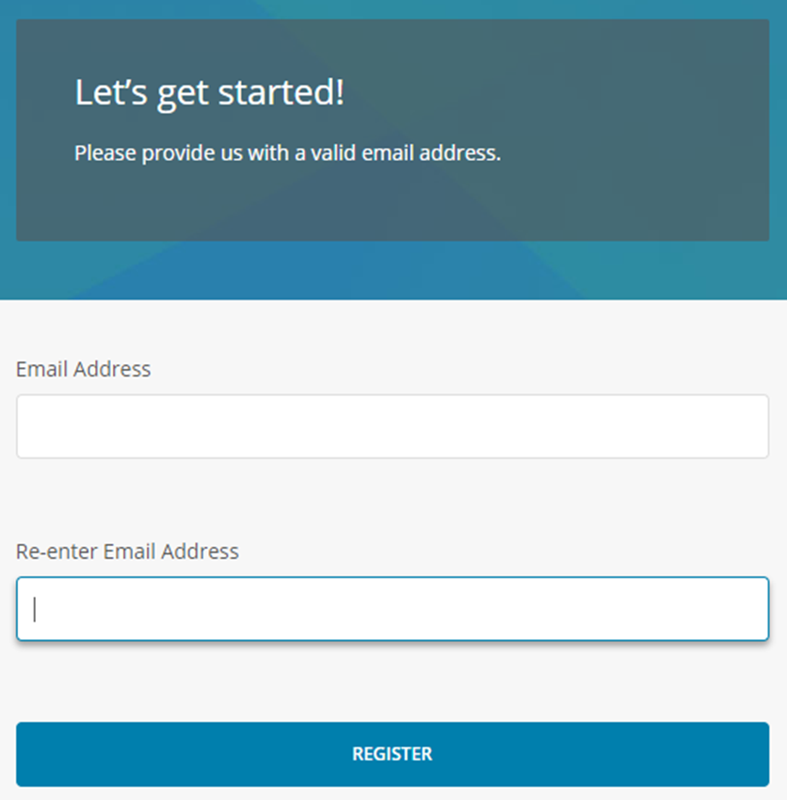
Enter your school email address and confirm a second time
Click REGISTER
Los Angeles | London | New Delhi | Singapore | Washington D.C | Melbourne

Slide 9
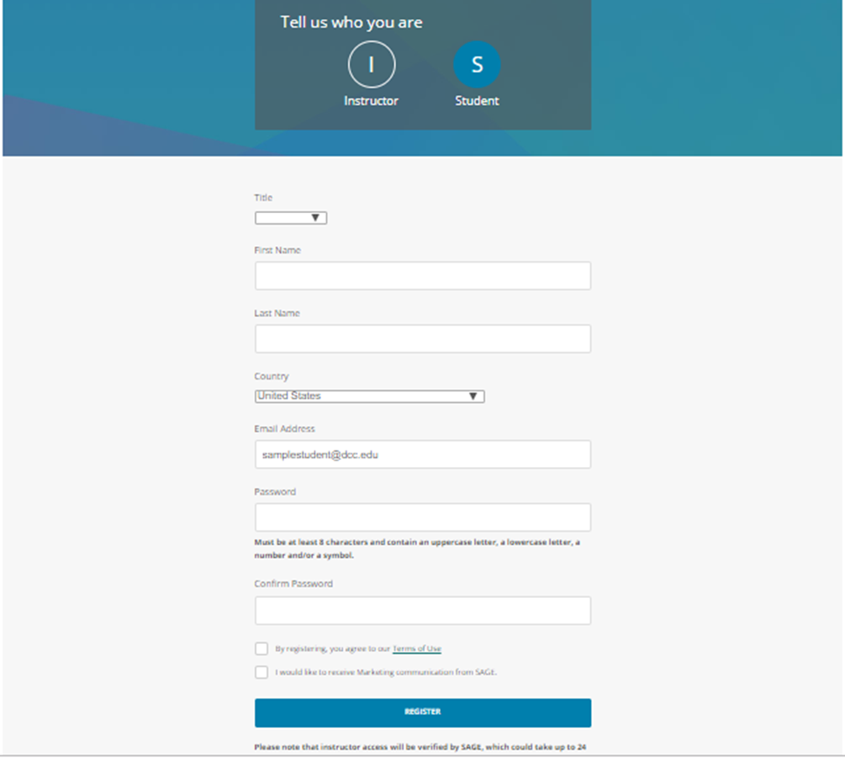
Fill in your name, email address and create password
Click “REGISTER”
Los Angeles | London | New Delhi | Singapore | Washington D.C | Melbourne

Slide 10
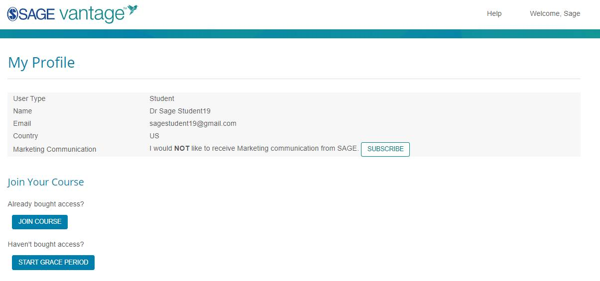
Verify your profile information is correct
Click “JOIN COURSE”
Los Angeles | London | New Delhi | Singapore | Washington D.C | Melbourne

Slide 11
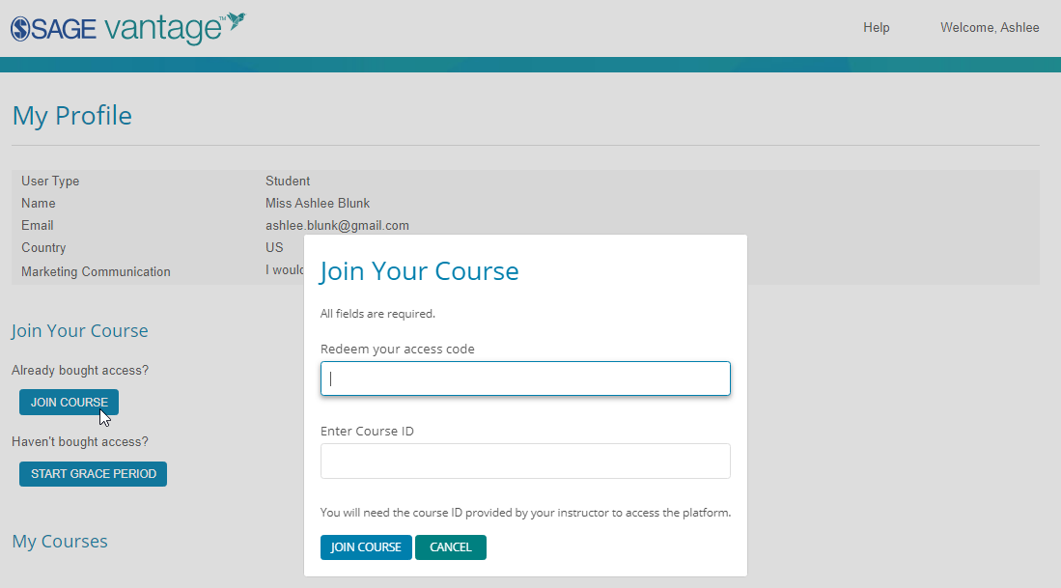
Type in your ACCESS CODE under “Redeem your access code”
Type in your COURSE ID
Click “JOIN COURSE”
Los Angeles | London | New Delhi | Singapore | Washington D.C | Melbourne

Slide 12
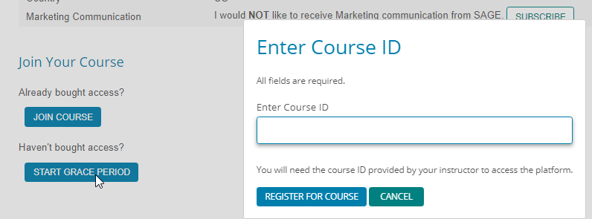
If you have not yet purchased access to Vantage
Click “START GRACE PERIOD”
Type in your COURSE ID from your instructor
Click REGISTER FOR COURSE
Los Angeles | London | New Delhi | Singapore | Washington D.C | Melbourne

Slide 13
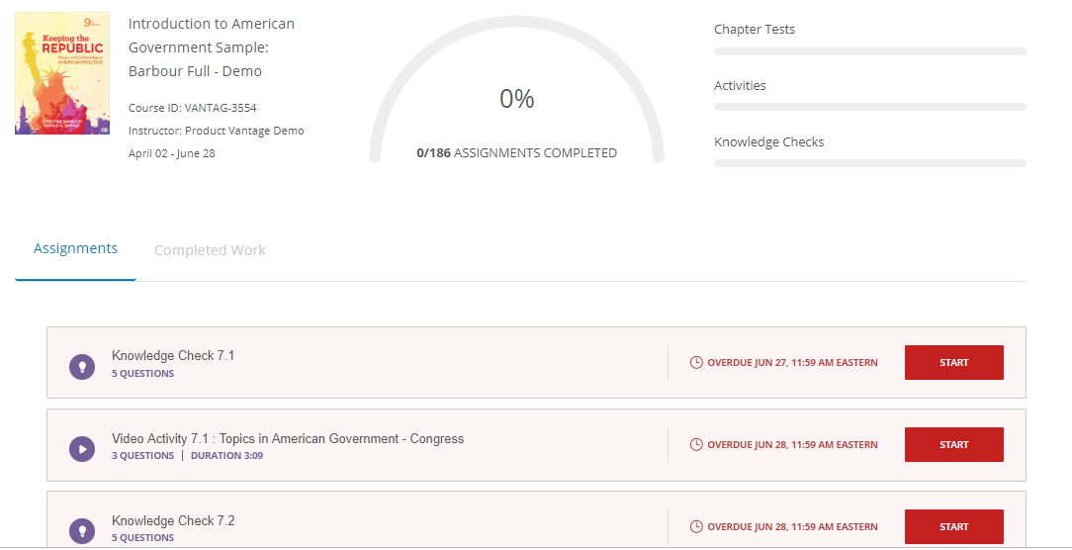
YOU ARE IN!
You can now use SAGE Vantage as a student for your course.
Going forward, login directly using your User Login and Password.
Los Angeles | London | New Delhi | Singapore | Washington D.C | Melbourne

Slide 14
YOU ARE READY-TO-GO
You can now use SAGE Vantage as a student for your course.
Going forward, login directly using your User Login and Password.
Los Angeles | London | New Delhi | Singapore | Washington D.C | Melbourne

Slide 15
CUSTOMER SUPPORT
Tech Support Help and Resources
Call (805) 410-7080 or (800) 818-7243 ext. 7080 for live support.
Tech Support Hours
Monday - Friday, 8:00 A.M. - 11:00 P.M. EST
Saturday: 11:30 A.M. – 8:00 P.M. EST
Sunday: 11:30 A.M. – 11:00 P.M. EST
Log a tech support ticket or get access to Videos & FAQ’s at https://sagevantage.softwareassist.com/
Los Angeles | London | New Delhi | Singapore | Washington D.C | Melbourne -- Jan 2020

