Slide 1
LMS Access Quick Start Guide
DATE & DETAILS
Los Angeles | London | New Delhi | Singapore | Washington D.C | Melbourne

Slide 2
HIGHLIGHTS
Dynamic Content
SAGE vantage seamlessly blends text content, videos, study tools and assignments to create a focused learning environment for students.
Knowledge Checks, Homework & Instant Feedback
Students get ample opportunity to check their understanding on readings, videos, and important concepts with knowledge checks, video activities and end of the chapter tests with instant feedback on their answers.
Accessible Anytime, Anywhere
SAGE vantage is cloud-based allowing students to access to course content from their internet-connected computer, tablet, or phone.
Value and Choice
SAGE vantage includes access to your eBook content, interactive videos, tests and assignments.
Los Angeles | London | New Delhi | Singapore | Washington D.C | Melbourne

Slide 3
BEFORE YOU START, YOU WILL NEED
An internet connection
Your LMS login (to Blackboard, Canvas, Brightspace, Moodle)
A Redemption Code OR a credit card to buy online
Los Angeles | London | New Delhi | Singapore | Washington D.C | Melbourne

Slide 4
STEP 1: LOG INTO YOUR LMS
Step 1: Log into your class’s Learning Management System (LMS) such as Blackboard, Canvas, Brightspace, Moodle
Los Angeles | London | New Delhi | Singapore | Washington D.C | Melbourne

Slide 5
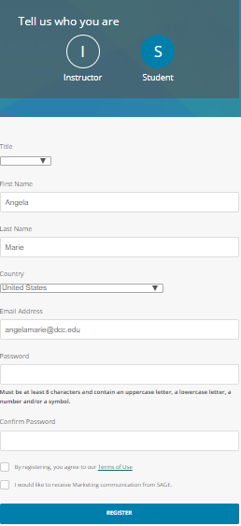
STEP 2: CLICK ON COURSE LINK
Click on the provided link in the LMS to open your SAGE vantage course.
Your information will auto populate.
You will have to enter a password and click the terms of use box.
Click Register.
Los Angeles | London | New Delhi | Singapore | Washington D.C | Melbourne

Slide 6
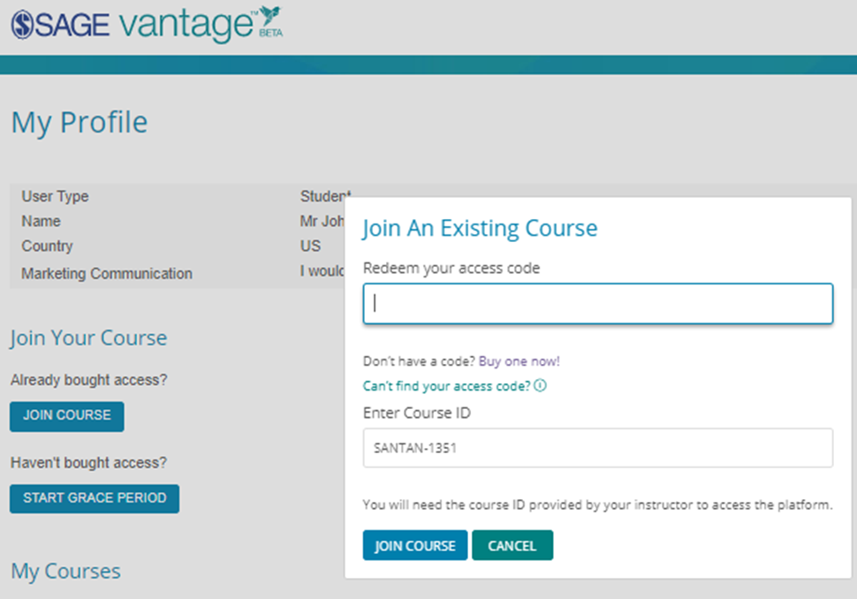
STEP 3: Redeem access code
Click JOIN COURSE if you have purchased the access code or click START GRACE PERIOD if you have not.
The COURSE ID will auto populate.
Click JOIN COURSE
Los Angeles | London | New Delhi | Singapore | Washington D.C | Melbourne

Slide 7
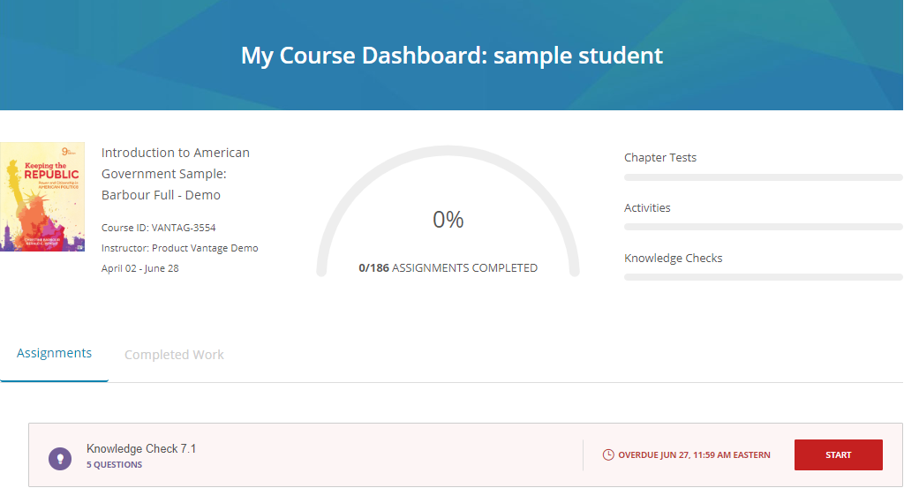
STEP 4: You are ready
You are now ready to begin reading and completing your assignments.
Los Angeles | London | New Delhi | Singapore | Washington D.C | Melbourne

Slide 8
YOU ARE READY-TO-GO
You can now use SAGE vantage as a student for your course. You can login directly through your LMS.
Los Angeles | London | New Delhi | Singapore | Washington D.C | Melbourne

Slide 9
CUSTOMER SUPPORT
For Tech Support Help and Resources Visit
www.sagepub.com/support
To Report an issue with SAGE vantage
www.sagepub.com/support
Call 1 (800) 818-7243 ext. 7080 or 1 (805) 410-7080
Live Support Available
Monday - Friday, 8:00 A.M. - 11:00 P.M. US EST
Saturday & Sunday: 11:30 a.m. – 8:00 P.M. US EST
Los Angeles | London | New Delhi | Singapore | Washington D.C | Melbourne

